Slide 1
Database Management
SQL part I
Angelehnt an Skript „Datenmodellierung und Datenmanagement“, THM
Mitwirkende Autoren: Prof. Dr. Guckert; Timo Péus, Dr. Thomas Farrenkopf,
Melanie Vanderpuye, Prof. Dr. Grüne (2017) mit eigenen Ergänzungen
Änderungen zur verwendeten DB-Engine (MS SQL Server 2017)
Prof. Dr. Markus Grüne, FB03, Wirtschaftsinformatik

Slide 2
Contents
Simple SQL statements and their interpretation
2

Slide 3
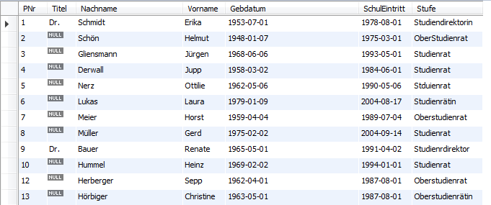
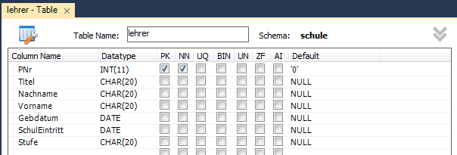
Example Table Lehrer
Database
Schema
3

Slide 4
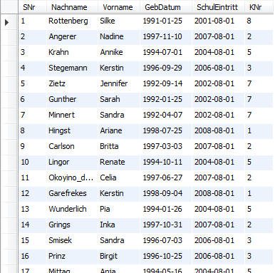
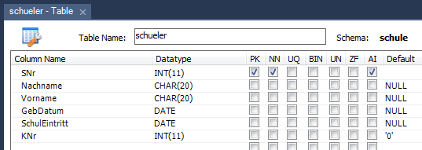
Example Schüler
Database
Schema
4
14.03.2018
Prof. Dr. Markus Grüne

Slide 5
SQL – sub sections
SQL=Structured Query Language
DML=DataManipulationLanguage
DDL=DataDefinitionLanguage
DCL=DataControlLanguage
Select, Update, Insert, Delete
Create …
Grant ….
5

Slide 6
SQL as Standard Query Language
Standardized (ISO)
Database Systems comply (at least to some extent) with the standard.
DML and DDL are more or less standard in DBS.
Differences in SQL depending on DBS
Column functions and DCL.
Procedures
6
Notes:
American National Standards Institute

Slide 7
Simple Select
SELECT [<columns>, *]
FROM <table(s)>
WHERE <Boolean expression for columns>
SELECT *
FROM LEHRER;
SELECT NACHNAME
FROM LEHRER
WHERE SCHULEINTRITT>“1997-11-01“;
Type dependent predicates in WHERE clause
7

Slide 8
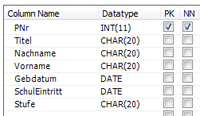
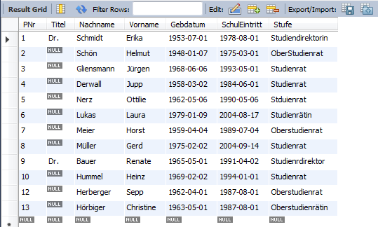
Beispiel I
All columns will be selected
8
14.03.2018
Prof. Dr. Markus Grüne

Slide 9
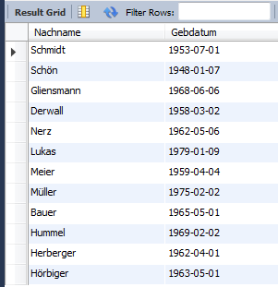
Beispiel II
Only 2 Columns
9
14.03.2018

Slide 10
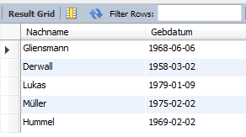
Beispiel III
Columns and Rows
10
14.03.2018

Slide 11
Sorting
SELECT *
FROM lehrer
ORDER BY nachname;
SELECT vorname, nachname
FROM lehrer
ORDER BY 2 ASC;
SELECT DISTINCT vorname
FROM schueler
ORDER BY 1 DESC
No duplicates
ASC=Ascending
DESC=Descending
Sort by 2nd column
11
Notes:
Was passiert hier?

Slide 12
Column Functions
SELECT NACHNAME
FROM LEHRER
WHERE YEAR(SCHULEINTRITT)>1970;
12

Slide 13
Column Functions (MySQL)
Adding columns
spalte1+spalte2, spalte1/365
Numerical operations
truncate(n,d)
Date operations
DAY, MONTH, YEAR, ADDDATE, YEAR(GEBDATUM), DATEDIFF(datum1,datum2)
Strings: Substring, concatenation,… SUBSTR(Nachname,1,1)
13
Notes:
Truncate: TRUNCATE(number, decimal_places)

Slide 14
Examples
Before leaving the job …
SELECT nachname, YEAR(NOW())-YEAR(gebdatum)
FROM lehrer
WHERE YEAR(NOW())-YEAR(gebdatum)>50;
Initials
SELECT CONCAT(SUBSTR(vorname,1,1),'.',SUBSTR(nachname,1,1))
FROM lehrer;
14

Slide 15
Conditions
Comparisons =, <,>,<=,>=,<>
Boolean operators AND, OR, NOT
Between <value> BETWEEN <value> AND <value>
Check for patterns <value> like “PATTERN%“, <value> like “PATTERN_“
Check by element <value> in (<value>,<value>,…,<value>)
use \ for masking
15
Notes:
% = 0-n Zeichen (*)
_ = 1 Zeichen (?)

Slide 16
Examples
select * from lehrer
where nachname like "M%";
select * from lehrer
where nachname like "M_ier";
select * from lehrer
where year(gebdatum) between 1960 and 1967;
select * from lehrer
where year(gebdatum) in (1960,1961,1962);
16

Slide 17
NULL
NULL is an undefined value which cannot be simply compared with other values.
Comparison only works with IS or IS NOT
SELECT nachname
FROM lehrer
WHERE titel = NULL;
SELECT nachname
FROM lehrer
WHERE titel IS NULL;
Negation: IS NOT NULL
Achtung: hier gibt es keinen Fehler, sondern eine fälschlicherweise leere Ergebnismenge
17

Slide 18
Set operations
List of persons
SELECT nachname, vorname, gebdatum
FROM lehrer
UNION
SELECT nachname, vorname, gebdatum
FROM schueler;
Delivers a set without duplicates.
18
14.03.2018
Prof. Dr. Markus Grüne

Slide 19
Renaming
SELECT nachname as nname
FROM lehrer l;
19

